Slide 1

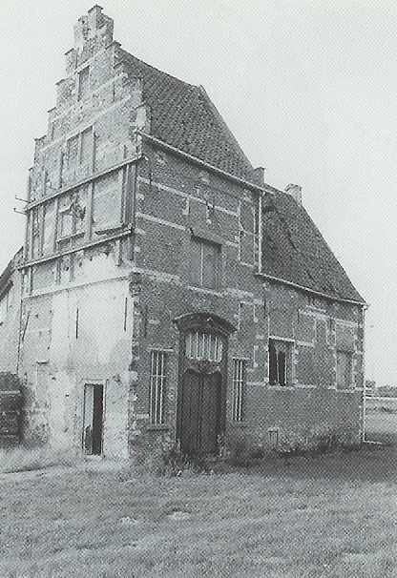




60min
CODE COMPLETE
Theoretical
Introduction
ArchitectureTrack

Slide 2


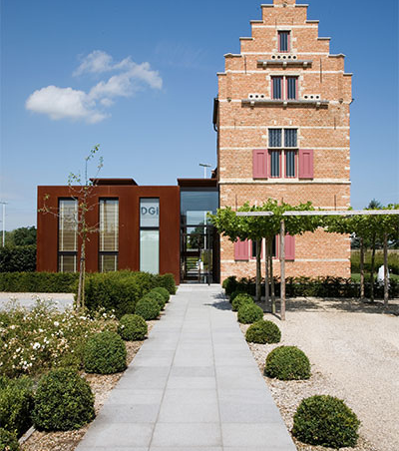

Menu
What
Book
… on Code

Slide 3

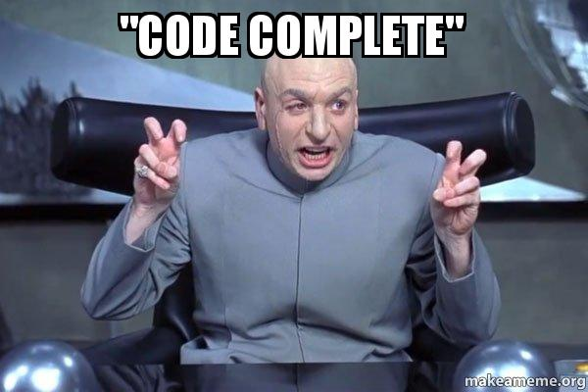

what does it even mean
Notes:
“Code Complete” (from the “Software release life cycle”)
A release candidate is called code complete when the dev team agrees no entirely new source code will be added to it.
So still room for config, data changes, bugfixes etc – but no show-stopping bugs have been discovered during testing.

Slide 4
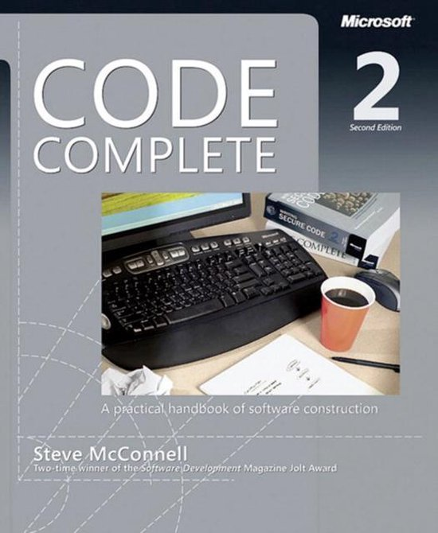
Code Complete?
Steve McConnell (1993 / 2004)
Microsoft Press
960 Pages 😱
Summary course: 8 hours
Backed with data from studies
…
We will have to be a bit more brief
And still end up with slides with copious amounts of text

Slide 5





The Coding Horror blog got its logo from Code Complete.

Slide 6

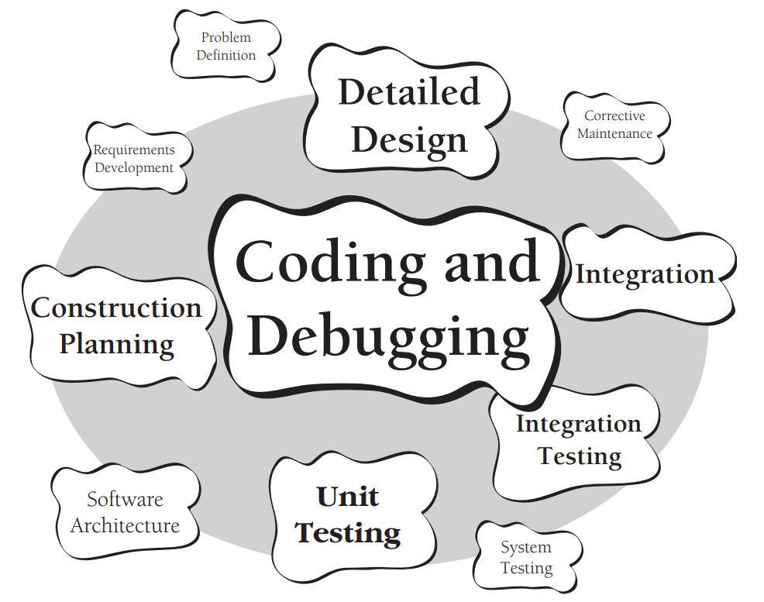
Code Complete
Book focus
30 to 80% of total time spent on the project
Often the only accurate description of the software
Construction: the only activity that’s guaranteed to be done

Slide 7
Code Complete
A practical handbook of software construction
7 Chapters
Laying the Foundation
Creating High-Quality Code
Variables
Statements
Code Improvements
System Considerations
Software Craftsmanship

Slide 8



Laying the Foundation

Slide 9
Software Development is
Writing Code
Pragmatic Programmers: like gardening
Donald Knuth: an art
Kent Beck: like driving a car
Fred Brooks: like farming, hunting werewolves, or drowning with dinosaurs in a tar pit
Building a house
Notes:
Writing Code:
The « letter writing » metaphor suggests that the process relies on expensive trial & error rather than careful planning and design.
Gardening:
Growing a system.
Better: « Software Oyster Farming » System Accretion – incremental, iterative, adaptive, evolutionary

Slide 10
Software Development is
Business systems tend to benefit from highly iterative approaches in which planning, requirements and architecture are interleaved with construction, system testing and qa.

Slide 11
Software Development is
Be more sequential when
(Fairly) stable requirements
Development team familiar with the domain
The design is straightforward and well understood
Building life-critical systems
Low risk projects
Notes:
Life-critical systems:
Stability + ultrahigh levels of reliability & long term predictability

Slide 12
Key Points
The best solution might not be a computer program
The Myth of Stable Requirements: The holy grail of software development
Good architecture makes construction easy. Bad architecture makes construction almost impossible
Generally 10-30% of the effort devoted to requirements, architecture and up-front planning
Requirement changes cost 20 to 100 times as much in the stages following construction
Notes:
Stable Requirements:
The more business, customers and the development team work on a project, the better they understand their own needs
This is a major source of requirement changes.
How much upfront?
The alternative to BDUF (Big Design Up Front) is not No Design Up Front but either
LDUF: Little Design Up Front
ENUF: Enough Design Up Front

Slide 13
Creating High-Quality Code

Slide 14



Managing Complexity
Software’s Primary Technical Imperative
Accidental
vs
Essential
The Mythical Man-Month (Fred Brooks)
“No Silver Bullet”
Notes:
All other technical goals are secondary to managing complexity
This makes many design considerations straightforward
Essential:
Minimize the essential complexity anyone’s brain has to deal with
Accidental:
Keep accidental complexity from needlessly proliferating

Slide 15
Design
“emergent” and “heuristic”
Design evolves and improves through design reviews, informal discussions, experience writing the code itself, and experience revising the code.
Do not settle for your first design.
Collaborate, Strive for simplicity.
Prototype when you need to.
Iterate, iterate, and iterate again.
Notes:
Heuristic:
A heuristic, or heuristic technique, is any approach to problem solving or self-discovery that employs a practical method that is not guaranteed to be optimal, perfect, or rational, but is nevertheless sufficient for reaching an immediate, short-term goal or approximation.

Slide 16
Design
Desirable Characteristics
Minimal complexity
Ease of maintenance
Loose coupling
Extensibility & Reusability
High fan-in & Low-to-medium fan-out
Leanness
Standard techniques
Notes:
Minimal complexity:
Avoid «clever» designs. Go for «simple» and «easy-to-understand».
The design should allow you to ignore most other parts of a program when immersed in one specific part.
Ease of maintenance:
Think of the maintenance programmer as your audience, and then design the system to be self-explanatory.
As noted earlier: 75% to 90% of work is maintenance work.
Loose coupling:
Design classes with as few interconnections as possible.
Extensibility:
The most likely changes cause the system the least trauma.
High fan-in:
Many classes use a given class.
Low-to-medium fan-out:
Use no more than about 7 other classes in a given class.
Leanness:
Design without extra parts.
Standard techniques
Do not rely on exotic pieces. Give the system a familiar feeling by using standardized, common approaches.
Stratification
Be able to look at a layer without needing to dig into lower level details.

Slide 17
Lean
Desirable Characteristics
Perfection is achieved, not when there is nothing more to add, but when there is nothing left to take away

Slide 18
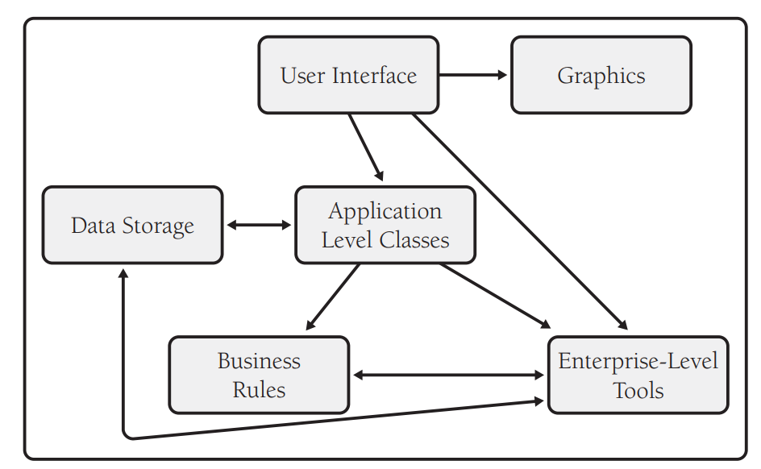
Packages / Projects / Subsystems
Ideally an acyclic graph

Slide 19
Design Building Blocks
Form Consistent Abstractions (ex: Aggregate)
Encapsulate Implementation Details
Inherit – When Inheritance Simplifies the Design
Hide Secrets (Information Hiding)
Identify Areas Likely to Change
Identify, Separate and Isolate
Common Design Patterns
Most problems are similar to past problems
Which can be solved by similar solutions, or patterns
Notes:
Abstractions allow you to ignore irrelevant details
Encapsulation allow only to look at an object at a high level
Information Hiding: Parnas was right, and I was wrong about Information Hiding (Fred Brooks)
Hide Secrets: An interface is like an iceberg – most should be hidden. It is an iterative process but if an interface doesn’t stabilize, you need to try a different approach. Hide complexity or to hide sources of change so that the effects remain localized.
Likely to change: Business Rules, Hardware dependencies, input/output, nonstandard language features, difficult design and construction areas, status variables, data-size constraints

Slide 20
Design Patterns
Hey, but, I already know most of these ideas!
That is exactly the power of the design pattern
Assign recognizable names for efficient communication
Move the design dialog to a higher level
Reduce complexity with ready-made abstractions
Notes:
.

Slide 21
Classes
Classes and routines are the foremost tools for reducing complexity.
If they are not making your job simpler, they’re not doing their jobs

Slide 22
Classes: Abstract Data Types
Work in the problem domain rather than in the low-level implementation domain
Hide implementation details
Changes don’t affect the whole program
Make the interface more informative
The program becomes more self-documenting
List<Employee> vs Employees

Slide 23
Classes: Abstract Data Types
Example
currentFont.size = 16 // pixels??
currentFont.setSizeInPixels(16)

Slide 24
Classes: Bad Abstraction
void InitializeCommandStack();
void PushCommand(Command command);
Command PopCommand();
void ShutdownCommandStack();
void InitializeReportFormatting();
void FormatReport(Report report);
void PrintReport(Report report);
void InitializeGlobalData();
void ShutdownGlobalData();

Slide 25
Classes: Better Abstraction
void InitializeUserInterface();
void ShutDownUserInterface();
void InitializeReports();
void ShutDownReports();

Slide 26
Classes: Good Abstraction
Classes with good abstraction have high cohesion
Present a consistent level of abstraction in the interface
Know and understand the abstraction implemented!!
Move unrelated information to another class
Beware of abstraction erosion under modification
Avoid semantic interfaces - the compiler should enforce
routineB cannot be called before routineA
routineC cannot be called if field Q is not set
Notes:
Aim for programmatic interface – enforced by the compiler
Avoid semantic interfaces – use Asserts if you have/need some semantic properties

Slide 27
Classes: Good Encapsulation
minimize class and member accessibility
Prefer the strictest level of privacy that is workable
Don’t make assumptions about the class’s user
Favor read-time convenience to write-time convenience
Be very, very wary of semantic violations of encapsulation
Anytime you look at a class implementation to figure how to use it, encapsulation is basically broken and abstraction won’t be far behind

Slide 28
Classes: Implementation
Containment vs Inheritance
Containment “has a”
The work-horse technique in OO
Be critical of classes with 7±2 data members
Inheritance “is a”
Make all data private, not protected
Adhere to the Liskov Substitution Principle
Avoid deep inheritance trees
Prefer polymorphism to extensive type checking
Notes:
7±2: the max amount of discrete things a human can remember while performing other tasks.

Slide 29
Classes: Implementation
So many rules for inheritance…
For the sake of controlling complexity, you should maintain a heavy bias against inheritance.

Slide 30
Classes: Reasons
Isolate complexity
Hide implementation details
Limit effects of changes
Hide global data
Streamline parameter passing
Make central points of control
Facilitate reusable code

Slide 31
Routines
The theoretical best max length is often described as one screen or 1-2 pages: approximately 50 to 200 lines

Slide 32
Routines: Reasons
Reduce complexity
Introduce an intermediate, understandable abstraction
Avoid duplicate code
Support subclassing
Hide sequences
Simplify complicated boolean tests
Easier to improve performance
Notes:
Intermediate Abstraction:
leafName = GetLeafName(node)

Slide 33
Routines: Naming
Describe everything the routine does (computeReportTotalsAndOpenOutputFile)
Avoid meaningless and vague verbs (HandleOutput, Calculate, ProcessInput)
Make names of routines as long as necessary
Use opposites precisely (add/remove, start/stop)
Establish conventions for common operations

Slide 34
Routines: Parameters
Always put similar parameters in the same order
Don’t use routine parameters as working variables
Document interface assumptions about parameters
Or even better: Assert your assumptions!
Limit to about 7 parameters

Slide 35
Routines: Multiple Returns
Use a return when it enhances readability
Use guard clauses to simplify complex error processing
Minimize the number of returns
' Guard clause
If Not file.ValidName() Then Exit Sub
If Not file.Open() Then Exit Sub
If Not encryptionKey.Valid() Then Exit Sub
If Not file.Decrypt(encryptionKey) Then Exit Sub

Slide 36
Routines: Complexity
1 point for each if/else/case, while/repeat/for, and/or
Score
0-5 Probably fine
6-10 Emerging refactor candidate
10+ Time to break it up

Slide 37
Exceptions
Use exceptions to notify other parts of the program about errors that should not be ignored
Throw an exception only for conditions that are truly exceptional
Throw exceptions at the right level of abstraction
Know the exceptions your library code throws
Consider building a centralized exception reporter
Avoid empty catch blocks
Include in the exception message all relevant data that led to it

Slide 38
Exceptions
Sometimes the right response to a serious run-time error is to abort and let the user rerun the program with proper input
A dead program normally does a lot less damage than a crippled one – The Pragmatic Programmers

Slide 39
Variables

Slide 40


Variables
Declare and initialize close to where first used
Use final or const whenever possible
Initialize members data in the constructor
Uninitialized variables are compiler warnings – head them
Start with the most restricted visibility, expand only if necessary
Keep variables “Live” for as short time as possible
Use each variable for one purpose only
Avoid variables with hidden meanings for certain values

Slide 41
Variables: Naming
Choose variable names with care
Should be readable, memorable, and appropriate
Stating in words what a variable represents is often the best name
Length: average between 8 to 20 chars for best debugging experience
“i” is still acceptable for short lived scratch value variables
Consider a naming convention
Make one global decision instead of many local ones
Any convention at all is often better than none
Compensate for language weaknesses

Slide 42
Variables: Naming
Avoid different meanings but similar names
Avoid multiple natural languages
Avoid misspelled words
Avoid words that are commonly misspelled
Avoid numerals

Slide 43
Variables: Abbrevations
Should be rarely needed
Abbreviate consistently
Create names that are pronounceable
Document all abbreviations

Slide 44
Variables: Booleans
Typical Boolean names: done, error, found, success, ok
Use names that imply true/false
Use positive Boolean variable names
Prefer forming positive expressions
Remove superfluous prefixes
isActive → active

Slide 45
Variables: Booleans
Use Booleans to
document your program
simplify complicated tests
if (elementIndex < 0 || MAX_ELEMENTS < elementIndex || elementIndex == lastElementIndex) {
// code
}
finished = elementIndex < 0 || MAX_ELEMENTS < elementIndex
repeatedEntry = elementIndex == lastElementIndex
if (finished || repeatedEntry) {
// code
}

Slide 46
Statements

Slide 47
Conditionals
How to if
Write the nominal path first; then the unusual cases
Put the most common cases first
Simplify complicated tests with function calls
Consider switch/case for if/then/else chains
Consider Table-Driven Methods

Slide 48
Loops
Each loop should perform only one function
Don’t monkey with the loop index
Avoid code that depends on the loop index’s final value
Avoid using i, j, k if the loop body is more than a couple of lines
Max length: 50 lines. Experts suggest one page.
Nesting: limit to 3
Make long loops especially clear:
a single exit point
a clear exit condition

Slide 49
Loops: Exiting Early
Consider using break rather than a Boolean variable
Be wary of a loop with many breaks scattered through it
Use continue for tests at the top of the loop
Use break and continue with caution
If you can’t defend a break/continue, don’t use it

Slide 50
And so much more…
Defensive & Offensive Programming
The Pseudocode Programming Process
Enums, Contants, Pointers, Structs, Global Data, …
Recursion, goto (a matter of religion)
Table-Driven Methods, Taming Deep Nesting
Notes:
Offensive Programming: Differentiate between development & production. Example switch/case with no match: do something in development & something else in prod

Slide 51
Code Improvements

Slide 52
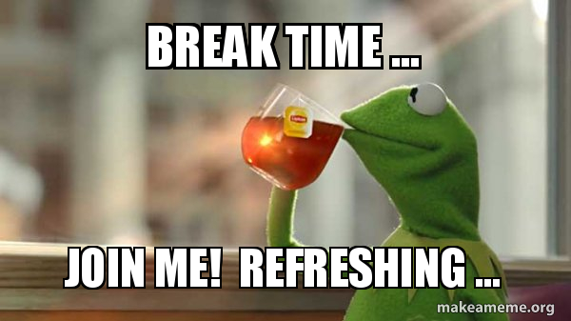
Halfway the book

Slide 53
Code Improvements

Slide 54



And more…
The “Just One More Compile” syndrome
Grow from superstition into understanding

Slide 55
Code Improvements

Slide 56

Menu
Thing 1

Slide 57
And more…
The “Just One More Compile” syndrome
Grow from superstition into understanding

Slide 58
Resources
Online course (8h)
It’s not for everyone (book review)
More positive book review (see infographic-book-best-chapters.png)

Slide 59
WiFi: itenium-guest / Wifi4Ufree
New WiFi: ITENIUM_GAST / FreeWifi

Slide 60



THANK YOU!

